Slide 1
Firm-Specific Human Capital, Organizational Incentives, and Agency Costs: Evidence from Retail Banking Douglas H. Frank and Tomasz Obloj
Presented by Bryn Choi
Spring 2023

Slide 2
Key Argument and Contribution
Previous literature: Incentives and human capital viewed as complementary
Strong financial incentives and highly skilled employees may be counterproductive for the firm:
Higher-human capital employees:
Greater potential to generate profits
➔ Higher returns to stronger incentives
Greater skill at exploiting incentive systems
➔ Lower returns to stronger incentives

Slide 3
Empirical Findings
Greater firm-specific human capital ~ 2% reduction in organization’s profits
Managers with superior organizational knowledge are:
More productive and more likely to manipulate terms to increase incentive payouts
% of profits lost due to incentive gaming increases more rapidly for managers with superior organizational knowledge (~learning ability)

Slide 4
Theory and Hypotheses
Hypothesis 1:
High FSHC will be associated with greater productivity.
Firm-specific human capital should lead to higher productivity (Hatch & Dyer, 2004).
Hypothesis 2:
High FSHC will be associated with increased incentive gaming.
-Human agency
-Division of labor
-Costs of monitoring
-Knowledge, abilities, skills
-Access to org. routines
Hypothesis 3a:
The net effect of high FSHC on organizational performance will be positive.
Hypothesis 3b:
The net effect of high FSHC on organizational performance will be negative.
Notes:
(capacity to make choices)
Specialization,
Access to organizational structure

Slide 5
Just as employees learn over time how to do their jobs more productively, they may also learn how to game incentives for their benefit.
Hypothesis 4:
Agency losses will increase at a faster rate for high levels of FSHC.
Higher levels of human capital should result in a faster pace of learning.
Agency losses due to gaming should increase over time.
Theory and Hypotheses

Slide 6
Empirical Context
Large private retail bank selling loans to customers.
Potential agency problems due to information asymmetry between bank executives and branch managers.
Managers’ effort is not directly observable or contractible.
Managers have local information about customers’ habits and preferences.
Managers are given some discretion over loan size, pricing, and approvals.
As an incentive, managers are rewarded based on loan sales.
Notes:
Formal - Practice of actively raising capital from a large public of investors for the purpose of undertaking new private ventures.

Slide 7
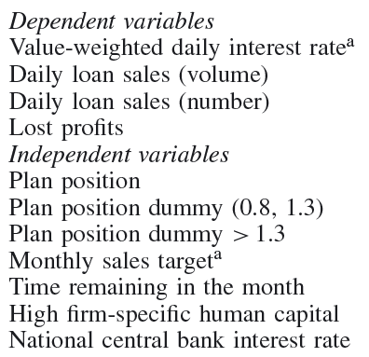
Empirical Context: Variables
= cumulative sales with w.r.t. monthly target
*
*Managers’ ability to predict sales targets
(reflects executives’ priorities, evaluation of future demand trends, and judgment of the manager’s ability; based on hidden algorithm)

Slide 8
Results: Effects of high FSHC
Hypothesis 1: FSHC is associated with increased productivity.
➔ Corroborated
High-FSHC managers sell 0.01 more loan units/day.
Hypothesis 2: Higher FSHC is associated with higher levels of incentive gaming. ➔ Corroborated
High-FSHC managers offer lower prices on average and use their discounting power more aggressively to meet sales targets.
The lower prices are sub-optimal for the firm, and lower interest rates may substitute for effort in selling loans.

Slide 9
Results: Net impact on firm profits
Lost profits = Observed profits –
Profits that would result if managers maintain price levels during week 4 (as instructed by executives)
Managers’ pricing decisions cost the bank 3% of its profits → The losses are significantly greater for high-FSHC managers.
Profits the bank would have earned if managers priced as monopolists under- estimated demand function
Managers’ pricing decisions cost the bank 12% of its profits → This loss is greater for high-FSHC managers.
Hypothesis 3b (Negative net effect of FSHC) ➔ Corroborated

Slide 10
Results: Dynamic effects of FSHC
B2 = positive → lost profits increase more rapidly for high-FSHC managers
Adverse learning is present and more pronounced for high-FSHC managers
Hypothesis 4 (Agency losses increase at a faster rate for higher FSHC
➔ Corroborated

Slide 11
Conclusion
Why don’t all employees behave opportunistically, as the agency model would suggest? ➔ Gaming the system is more widespread among employees with greater insight into the firm’s internal operations
Firms periodically change incentive plans (and conceal target-setting criteria) for a reason.

Slide 12
Discussion
Which of the potential solutions suggested by the authors should be most effective?
Periodically change incentive plans.
Reduce the strength of incentives.
Commit to a linear bonus schedule, rather than one that accelerates at certain thresholds.
Strengthen its recruiting procedures and/or replace high-FSHC managers.

